Slide 1

Abstract Classes and Interfaces
Chapter 13

Slide 2
Abstract classes
Abstract classes in Java serve as blueprints for other classes.
They allow you to define methods that must be implemented by subclasses while also providing concrete methods that can be shared across those subclasses.
Here's a detailed discussion on abstract classes in Java along with examples:

Slide 3
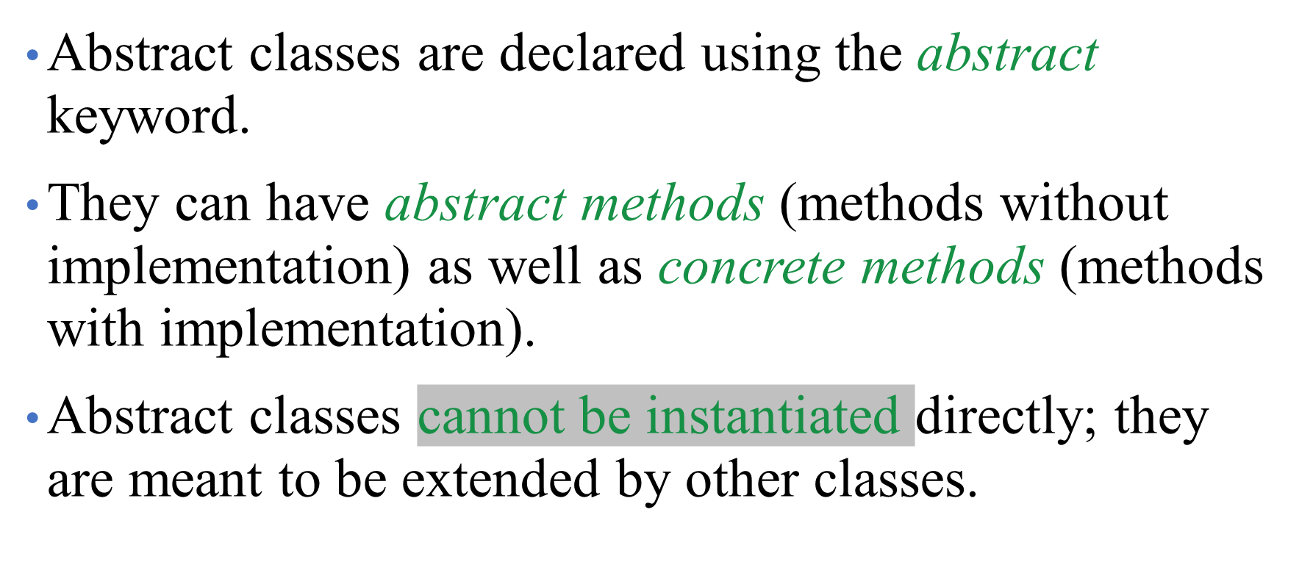
Abstract Class Declaration
Notes:
Break 161, 162

Slide 4
Abstract Method
An abstract method is a method declared without a body.
It is meant to be implemented by concrete subclasses.
Abstract methods are declared with the abstract keyword and terminated with a semicolon.
Subclasses that extend an abstract class must provide implementations for all abstract methods.

Slide 5
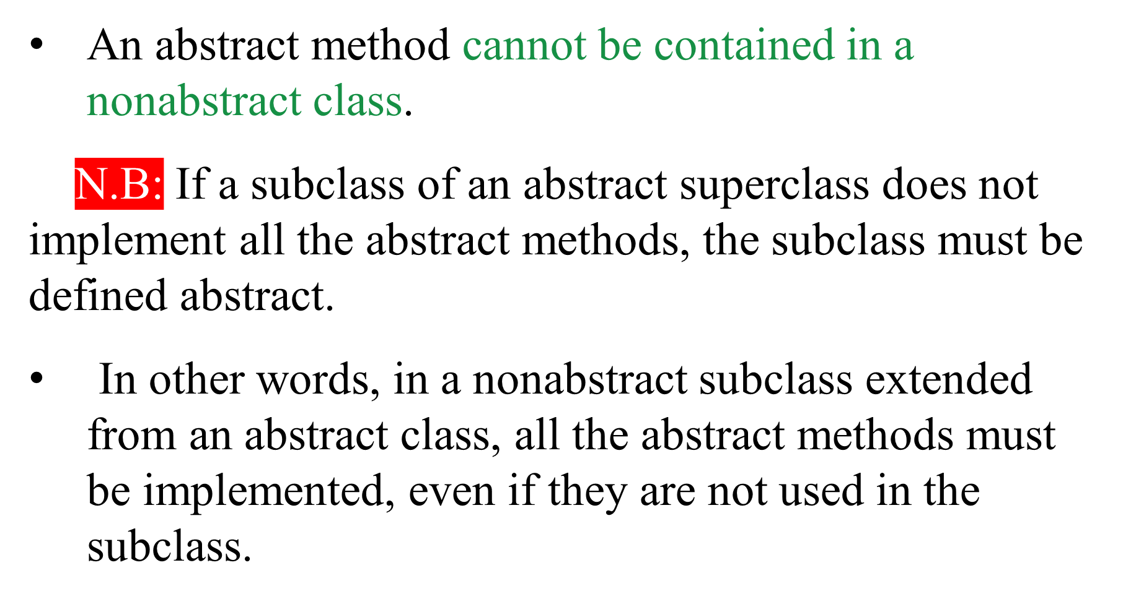
Abstract Method

Slide 6
Concrete Method
Concrete methods are fully implemented methods.
They provide common functionality that can be reused by subclasses.
Concrete methods are defined as regular methods inside the abstract class.

Slide 7
Constructor
Abstract classes can have constructors.
Subclasses must call one of the constructors from the abstract class using super() in their own constructors.

Slide 8
Purpose of the Abstract class
Abstract classes are used to define a common interface and behaviour for a group of related classes.
They help in achieving abstraction and code reusability.

Slide 9
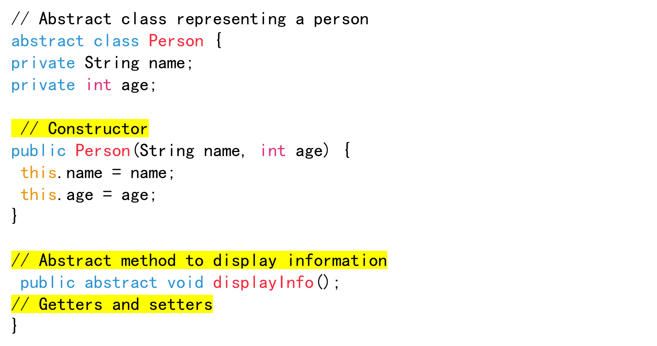
Example of an abstract class

Slide 10
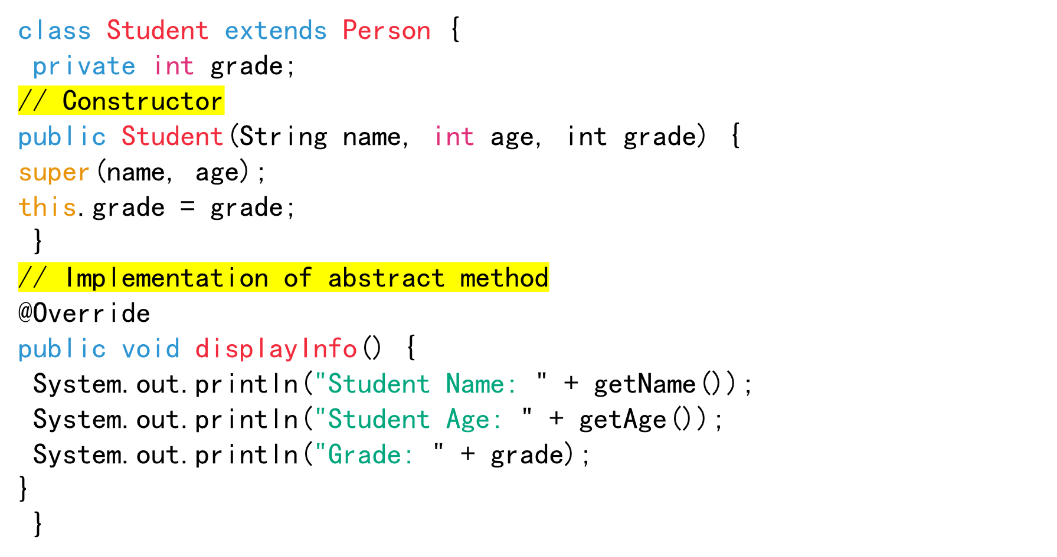
// Concrete subclass representing a student

Slide 11
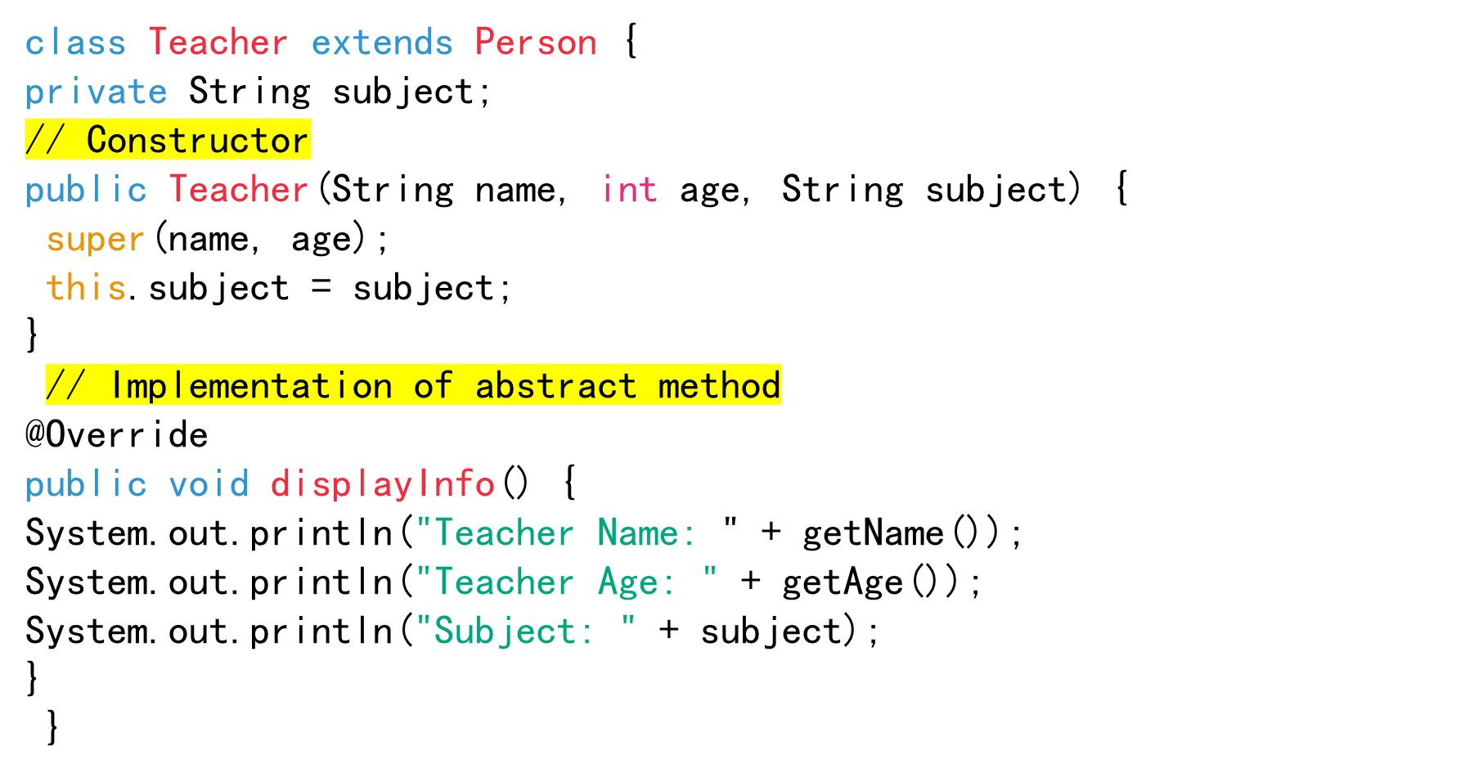
// Concrete subclass representing a teacher

Slide 12
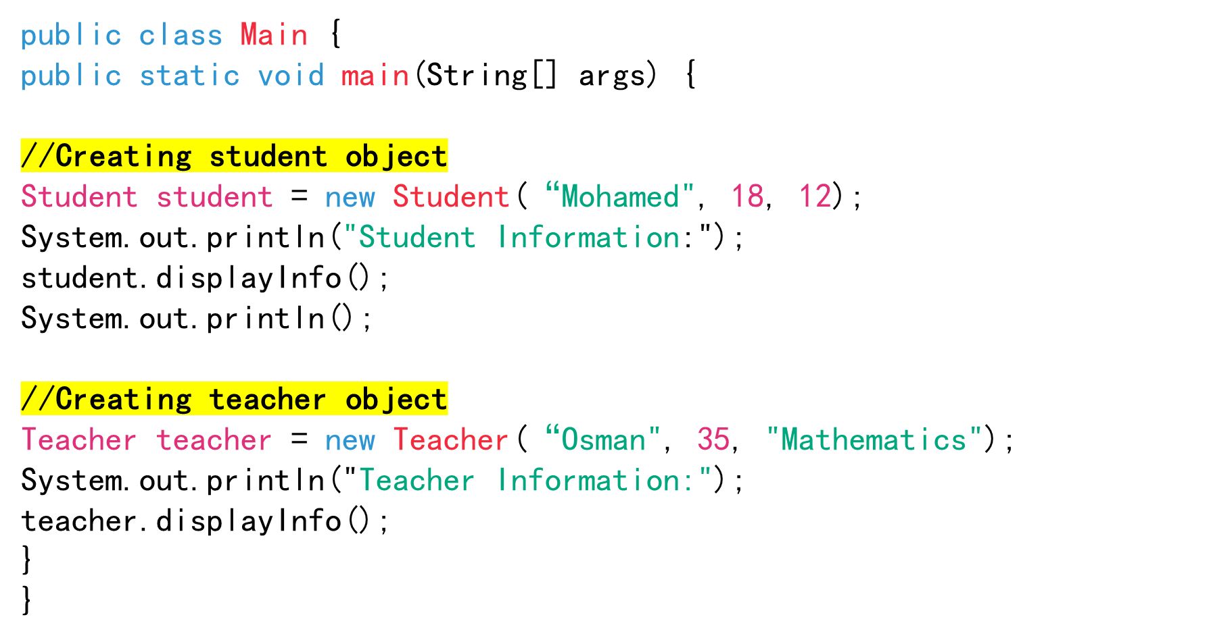
// Main class to demonstrate usage

Slide 13
….
In this example:
Person is an abstract class with attributes name and age, and an abstract method displayInfo().
Student and Teacher are concrete subclasses of Person, each providing its own implementation of the displayInfo() method.
The Main class demonstrates creating instances of Student and Teacher and calling their displayInfo() methods.
This structure allows you to define common behavior and attributes in the Person class while allowing specific implementations in its subclasses Student and Teacher.

Slide 14
abstract class as type
You cannot create an instance from an abstract class using the new operator, but an abstract class can be used as a data type.
Therefore, the following statement, which creates an array whose elements are of Person type, is correct.
Person[] ob = new Person[10];

Slide 15
Interfaces
What is an interface?
Why is an interface useful?
How do you define an interface?
How do you use an interface?

Slide 16
What is an interface?
Why is an interface useful?
An interface is a class-like construct that contains only constants and abstract methods.
In many ways, an interface is similar to an abstract class, but the intent of an interface is to specify common behaviour for objects.
For example, you can specify that the objects are comparable, edible, cloneable using appropriate interfaces.
Interfaces facilitate multiple inheritance, allowing a class to implement multiple interfaces.

Slide 17
Interface is a Special Class
An interface is treated like a special class in Java.
Each interface is compiled into a separate bytecode file, just like a regular class.
Like an abstract class, you cannot create an instance from an interface using the new operator, but in most cases you can use an interface more or less the same way you use an abstract class.

Slide 18
Define an Interface
To distinguish an interface from a class, Java uses the following syntax to define an interface:
interface MyInterface {
// Method signatures
void method1();
void method2();
// Constant variables
int MAX_VALUE = 100;
}

Slide 19
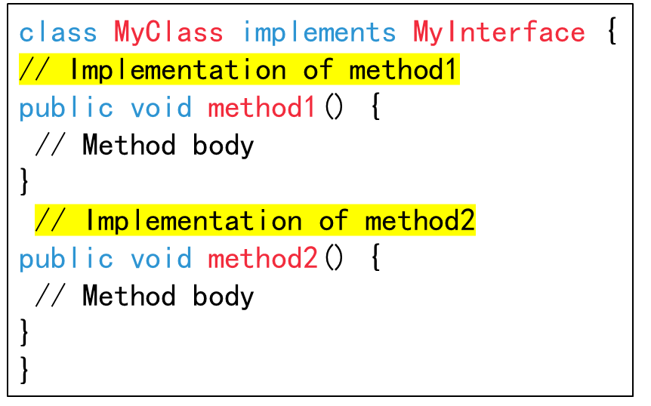
How do You Use an Interface?
Implementing Interfaces:
To use an interface, you create a class that implements it.
The implementing class must provide concrete implementations for all the methods defined in the interface.

Slide 20
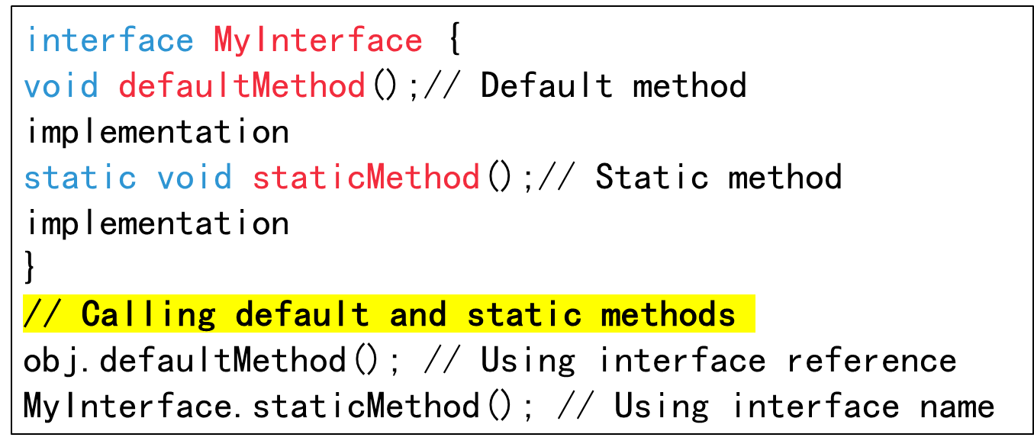
How do You Use an Interface?
Default and Static Methods:
Interfaces can contain default and static methods, which can be called by interface references or using the interface name itself.

Slide 21
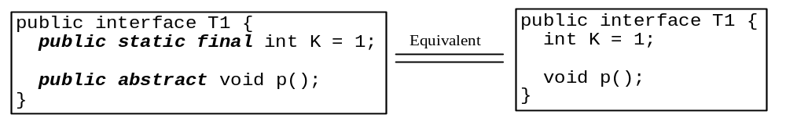
Omitting Modifiers in Interfaces
  All data fields are public final static and all methods are public abstract in an interface. For this reason, these modifiers can be omitted, as shown below:
  A constant defined in an interface can be accessed using syntax InterfaceName.CONSTANT_NAME (e.g., T1.K).

Slide 22
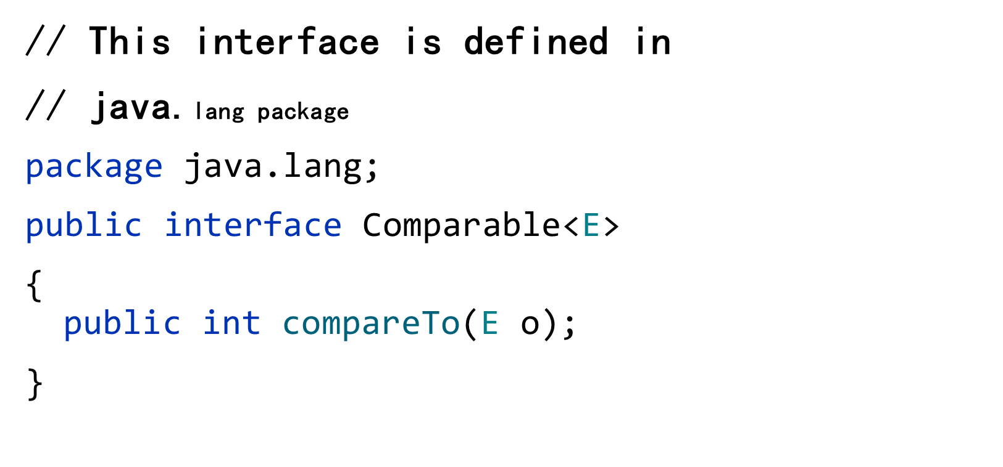
Example: The Comparable Interface

Slide 23
The Comparable Interface
The Comparable interface in Java is used to define a natural ordering for a class.
It is found in the java.lang package and contains only one method, compareTo(), which compares the current object with another object of the same type.
This interface is commonly used to sort objects or maintain them in a specific order, such as in collections like TreeSet or when using sorting algorithms like Collections.sort().

Slide 24
The toString, equals, and hashCode Methods
Each wrapper class overrides the toString, equals, and hashCode methods defined in the Object class.
Since all the numeric wrapper classes and the Character class implement the Comparable interface, the compareTo method is implemented in these classes.

Slide 25
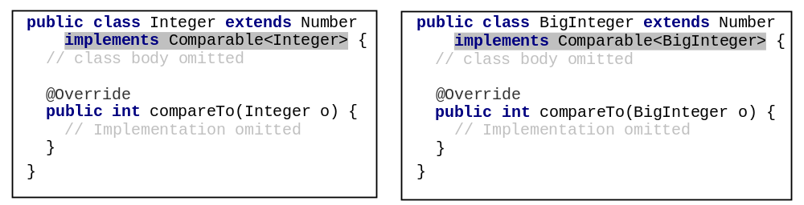
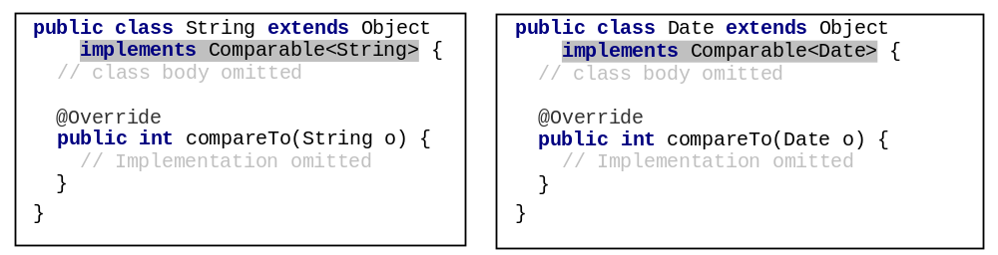
Integer and BigInteger Classes
String and Date Classes

Slide 26
Example
1 System.out.println(new Integer(3).compareTo(new Integer(5)));
2 System.out.println("ABC".compareTo("ABE"));
3 java.util.Date date1 = new java.util.Date(2013, 1, 1);
4 java.util.Date date2 = new java.util.Date(2012, 1, 1);
5 System.out.println(date1.compareTo(date2));

Slide 27
The Cloneable Interfaces
  Marker Interface: An empty interface.
  The Cloneable interface in Java serves as a marker interface, indicating that the objects of a class can be cloned.
  However, it doesn't contain any methods; instead, it merely serves to indicate to the JVM that it's permissible to use the clone() method on instances of the implementing class.

Slide 28
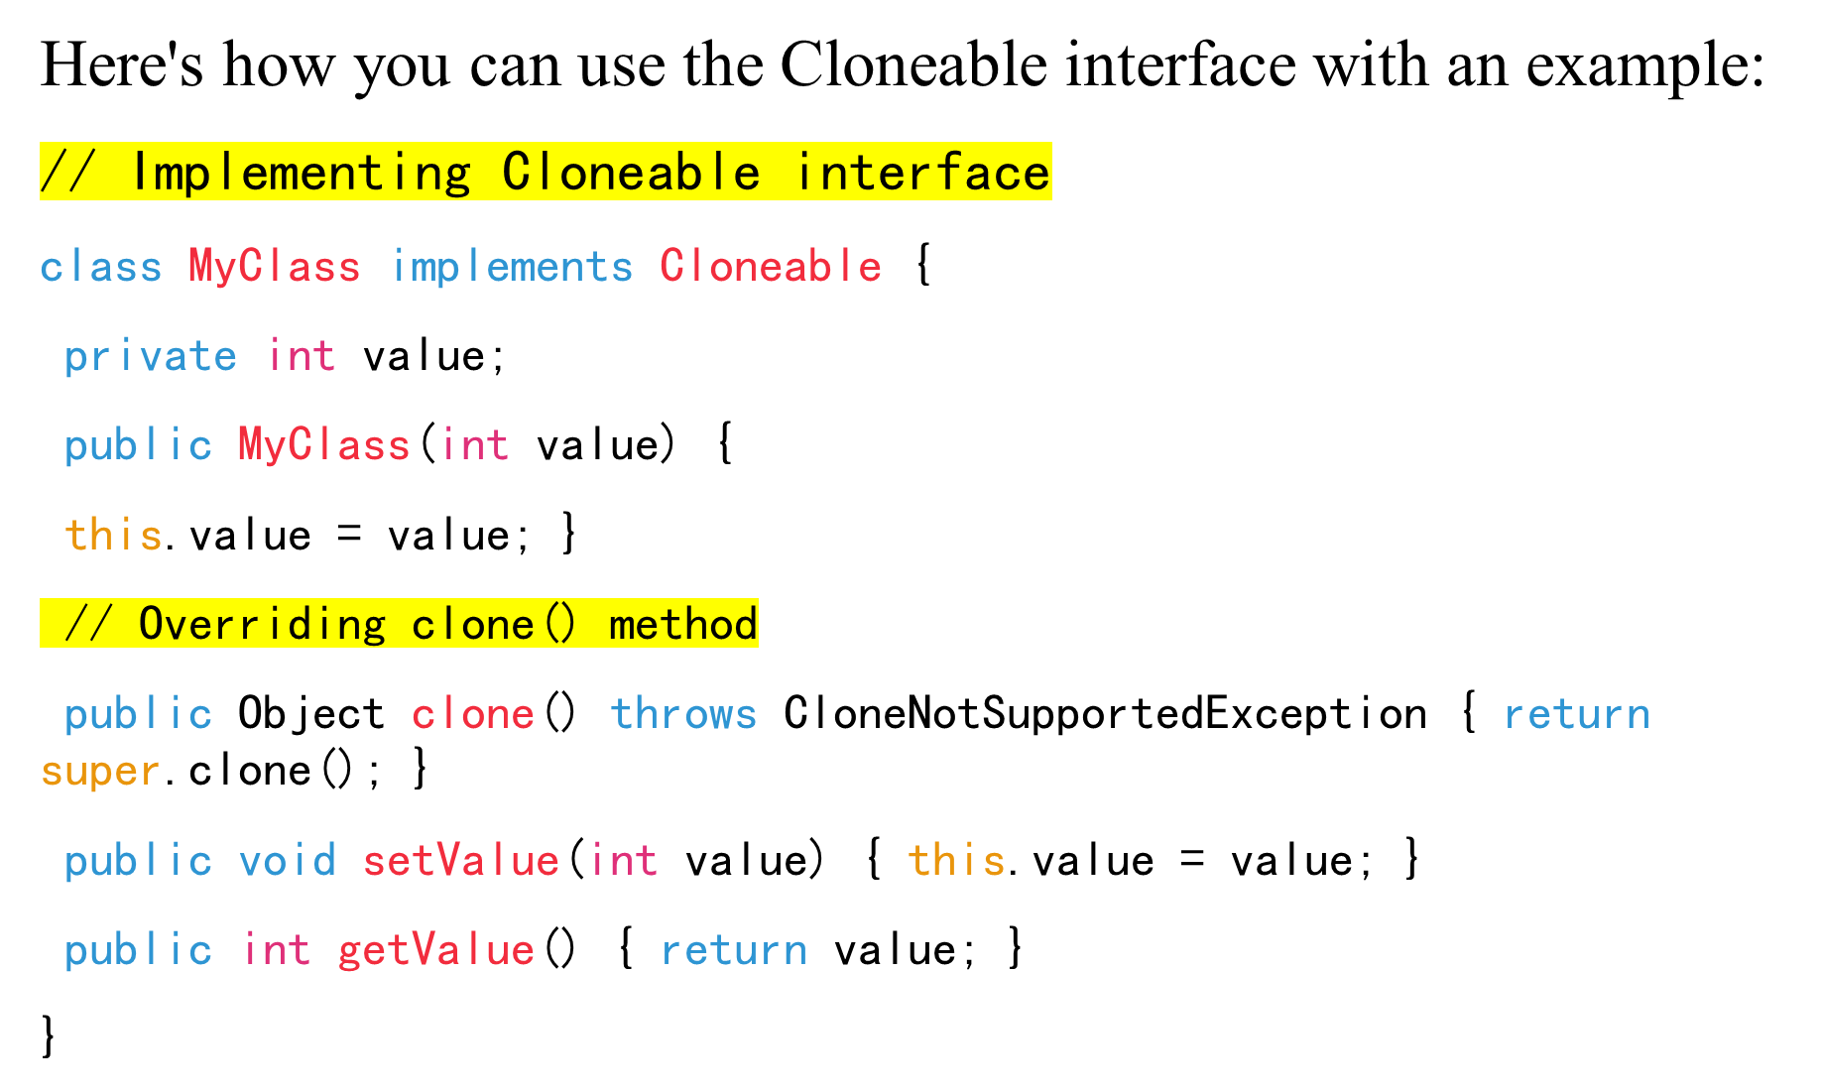

Slide 29
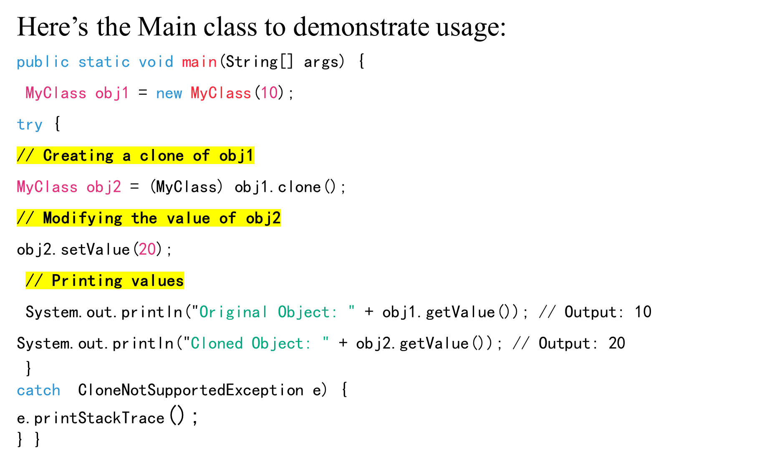

Slide 30
In this example:
MyClass implements the Cloneable interface.
The clone() method is overridden to provide a public implementation of object cloning.
In the main() method, we create an instance of MyClass named obj1.
We then clone obj1 to create a new object obj2 using the clone() method.
After that, we modify the value of obj2.
We print the values of both obj1 and obj2 to verify that they are independent of each other.

Slide 31
Why is an Interface Useful?
Abstraction: Interfaces allow you to define a set of methods without specifying their implementations, providing a high level of abstraction.
Polymorphism: Interfaces enable polymorphic behaviour, where different classes can be treated uniformly through a common interface reference.
Standardization: Interfaces define contracts between classes, ensuring that implementing classes provide certain functionalities.

Slide 32
Why is an Interface Useful?...
Multiple Inheritance: Java interfaces allow a class to inherit behaviours from multiple sources, unlike classes, which can inherit from only one superclass.
Flexibility: Interfaces provide flexibility in design by allowing classes to implement multiple interfaces, promoting loose coupling between components.

Slide 33
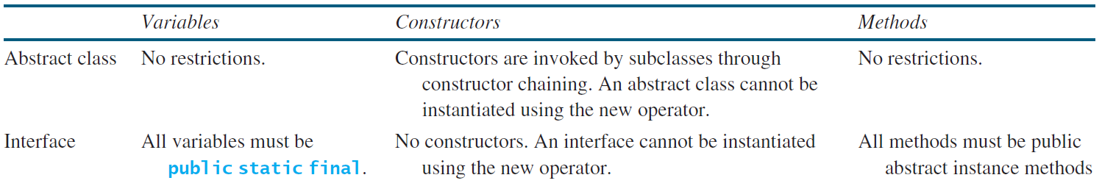
Interfaces vs. Abstract Classes
  In an interface, the data must be constants; an abstract class can have all types of data.
  Each method in an interface has only a signature without implementation; an abstract class can have concrete methods.

Slide 34
Interfaces vs. Abstract Classes, cont.
  All classes share a single root, the Object class, but there is no single root for interfaces.
  Like a class, an interface also defines a type.
  A variable of an interface type can reference any instance of the class that implements the interface.
  If a class extends an interface, this interface plays the same role as a superclass.
  You can use an interface as a data type and cast a variable of an interface type to its subclass, and vice versa.

Slide 35

  In rare occasions, a class may implement two interfaces with conflict information (e.g., two same constants with different values or two methods with same signature but different return type).
  This type of errors will be detected by the compiler.

Slide 36
Shallow vs. Deep Copy
In Java, when you need to duplicate an object, you can perform either a shallow copy or a deep copy.
Understanding the difference between these two approaches is crucial as it affects how changes to the copied object impact the original object.

Slide 37
Shallow Copy
In a shallow copy, only the top-level structure of the object is duplicated.
If the object contains references to other objects, only the references are copied, not the actual objects themselves.
As a result, both the original object and the copied object share the same references to the objects they point to.
Changes made to the internal state of the referenced objects in one copy are reflected in the other copy since they point to the same memory locations.

Slide 38
Deep Copy
In a deep copy, not only the top-level structure of the object but also all the nested objects are duplicated recursively.
Each object and its nested objects are duplicated, creating separate copies with their own distinct memory locations.
Changes made to the internal state of an object or its nested objects in one copy do not affect the other copy, as they operate on separate memory locations.

Slide 39
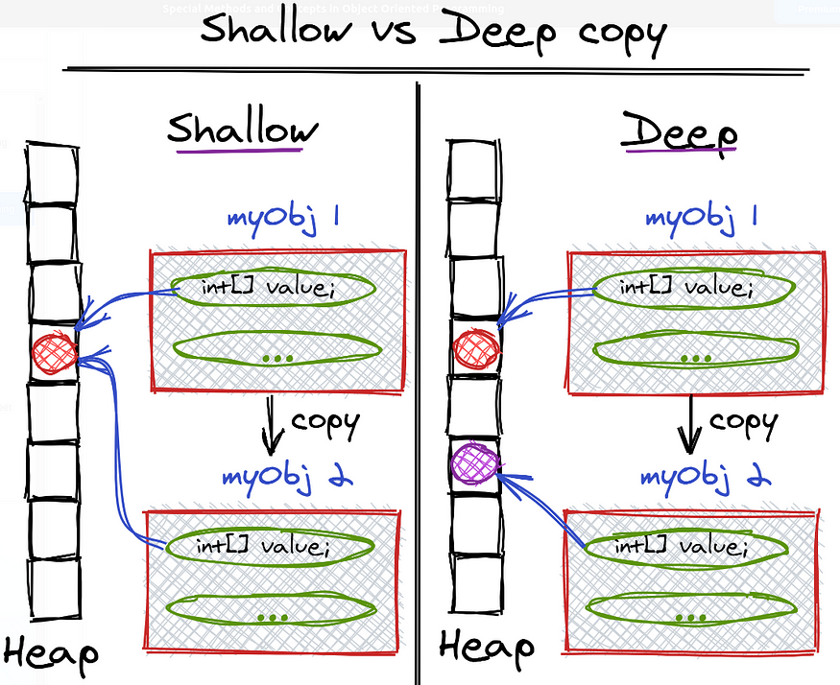
source : algodaily.com

Slide 40
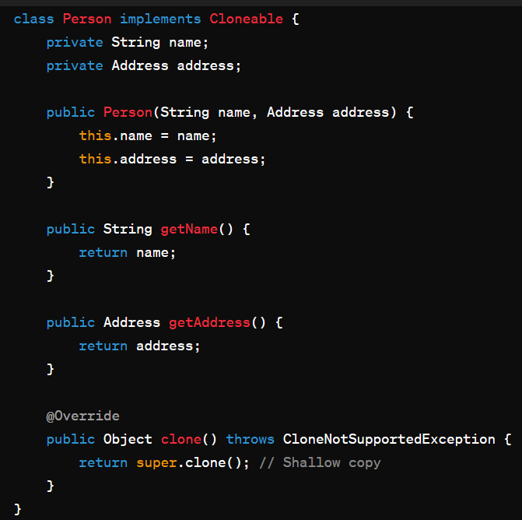
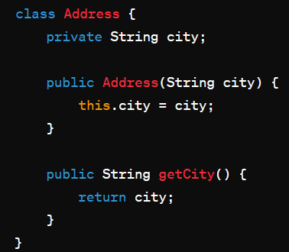
Let's illustrate the concepts of shallow and deep copy with a simple example in Java:
Consider a class “Person” with a nested object “Address”:

Slide 41
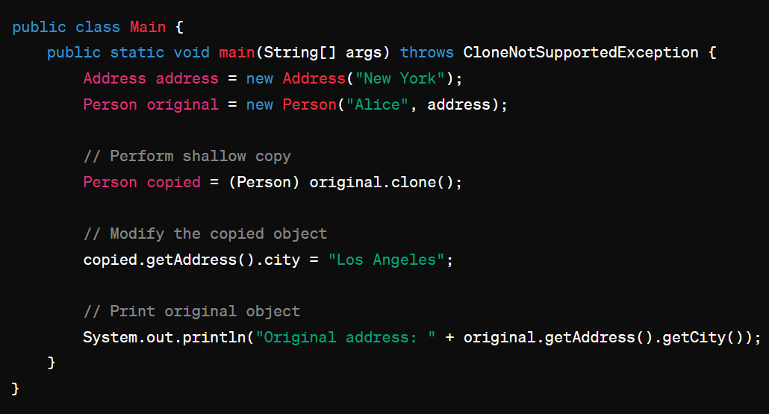
Now, let's demonstrate shallow and deep copy:
Shallow Copy Example:
// Output: Los Angeles
In the above example, even though we modified the address of the copied object, it also affected the address of the original object. This is because the clone() method performs a shallow copy, so the address reference is shared between the original and copied objects.

Slide 42
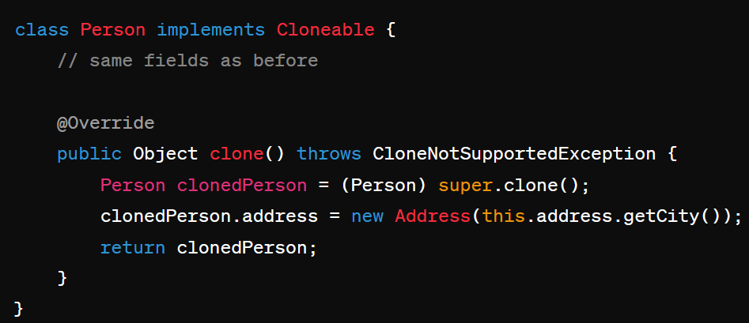
Deep Copy Example:
To achieve deep copy, you need to implement custom logic:
// Perform deep copy of Address

Slide 43
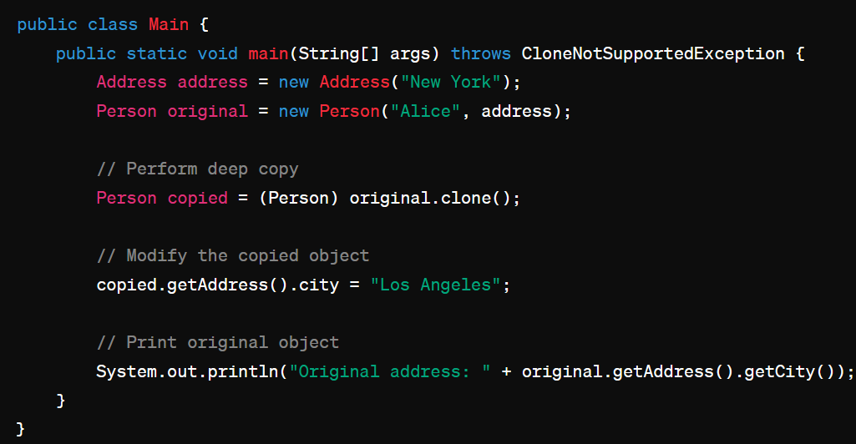
Now, let's use the deep copy implementation:
// Output: New York
In this example, modifying the address of the copied object does not affect the address of the original object because a deep copy was performed, creating separate instances of the Address object for each Person object.

Slide 44
Designing a Class
(Coherence)
A class should describe a single entity, and all the class operations should logically fit together to support a coherent purpose.
You can use a class for students, for example, but you should not combine students and staff in the same class, because students and staff have different entities.

Slide 45
Designing a Class, cont.
(Separating responsibilities)
A single entity with too many responsibilities can be broken into several classes to separate responsibilities.
The classes String, StringBuilder, and StringBuffer all deal with strings, for example, but have different responsibilities.
The String class deals with immutable strings, the StringBuilder class is for creating mutable strings, and the StringBuffer class is similar to StringBuilder except that StringBuffer contains synchronized methods for updating strings.

Slide 46
Designing a Class, cont.
Classes are designed for reuse.
Users can incorporate classes in many different combinations, orders, and environments. Therefore, you should design a class that imposes no restrictions on what or when the user can do with it, design the properties to ensure that the user can set properties in any order, with any combination of values, and design methods to function independently of their order of occurrence.

Slide 47
Designing a Class, cont.
Provide a public no-arg constructor and override the equals method and the toString method defined in the Object class whenever possible.

Slide 48
Designing a Class, cont.
Follow standard Java programming style and naming conventions. Choose informative names for classes, data fields, and methods.
Always place the data declaration before the constructor, and place constructors before methods.
Always provide a constructor and initialize variables to avoid programming errors.

Slide 49
Using Visibility Modifiers
Each class can present two contracts – one for the users of the class and one for the extenders of the class.
  Make the fields private and accessor methods public if they are intended for the users of the class.
  Make the fields or method protected if they are intended for extenders of the class. The contract for the extenders encompasses the contract for the users.
  The extended class may increase the visibility of an instance method from protected to public, or change its implementation, but you should never change the implementation in a way that violates that contract.

Slide 50
Using Visibility Modifiers, cont.
A class should use the private modifier to hide its data from direct access by clients. You can use get methods and set methods to provide users with access to the private data, but only to private data you want the user to see or to modify.
A class should also hide methods not intended for client use.

Slide 51
Using the static Modifier
A property that is shared by all the instances of the class should be declared as a static property.

Slide 52
END

